Slide 1
Core Java

Slide 2
Version Control and Revision History
 | Name | Date
Prepared By | Paranthaman | 09-07-2019
Reviewed By | Team | 09-07-2019
Approved By | Team | 09-07-2019
Version No. | Date | Affected Sections | Highlights
2.0.0 |  | ALL | Updated Based on the course sheet coverage

Slide 3








Iconic Representations.......
Test your Memory
Can you Solve?
Objective
Coffee Break
Queries
Recap
Need more Info
Brainstorm

Slide 4
Objective
Java Editions
Java Based Platforms
Type of Applications
Frameworks
Java Based Servers
Java 5.0,6.0,7.0,8.0 Features
JAVA APIs
J2EE APIs

Slide 5
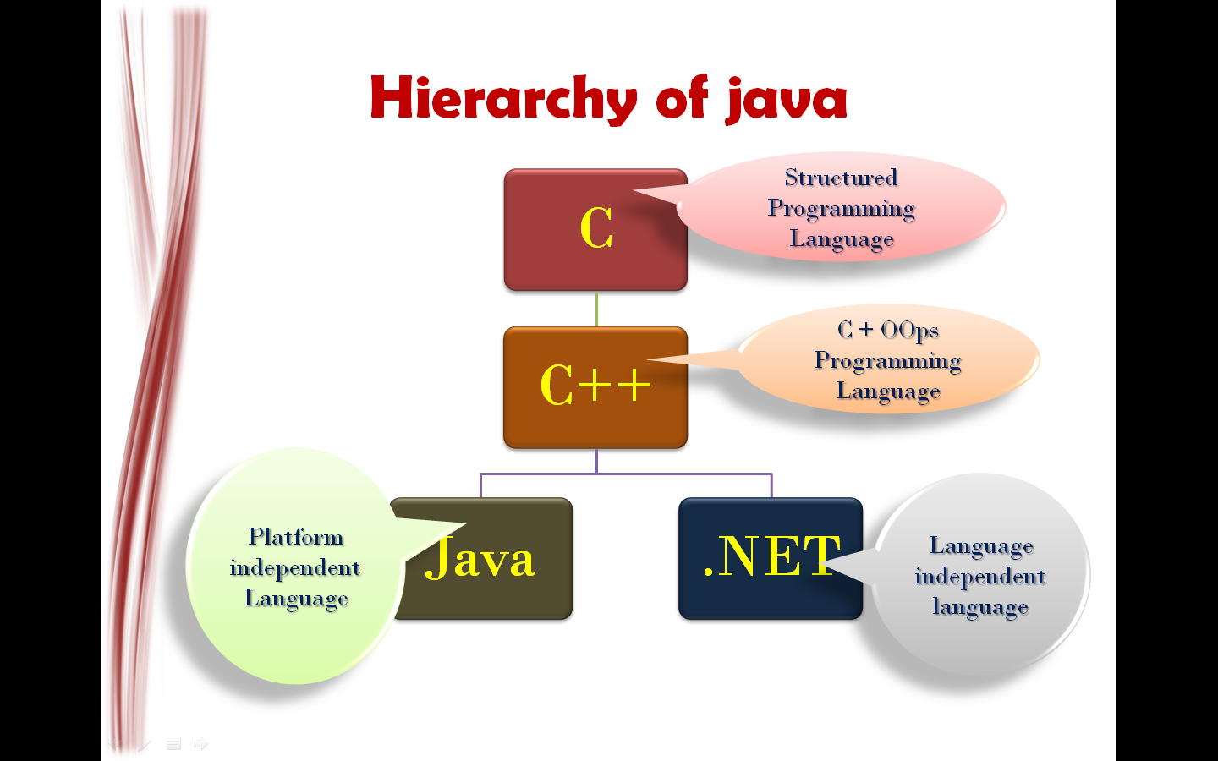
JAVA Hierarchy
Java is both a programming language and a platform.

Slide 6
Characteristics of JAVA
Simple and Object Oriented
Robust and Secure
Standalone & Distributed
Architecture Neutral and Portable
High Performance
Interpreted, Threaded, and Dynamic

Slide 7
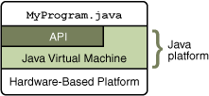
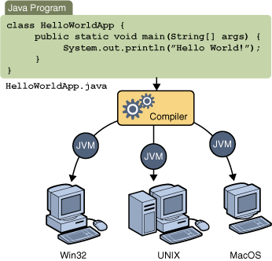
JAVA Platform
Java platform has two components
The Java Virtual Machine
The Java Application Programming Interface (API)
JAVA is Platform Independent but JVM is platform dependent.

Slide 8
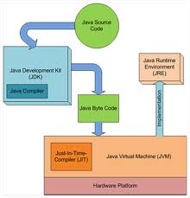
JRE vs. JDK
Java Source Code
Java Runtime Environment (JRE)
Java Development Kit(JDK)
Java Compiler
Java Byte Code
Just-In-Time Compiler(JIT)
Java Virtual Machine(JVM)
Hardware Platform

Slide 9

Java Language Runtime Environment

Slide 10
JAVA Editions and Platforms
Java Editions
J2SE
J2EE
J2ME
JVM
Web Container
EJB Container
KVM
Servlet & JSP
EJB
J2ME

Slide 11
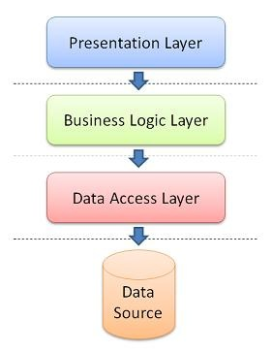
Application Layers

Slide 12
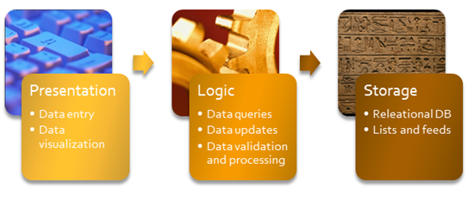
Coding in application Layers

Slide 13
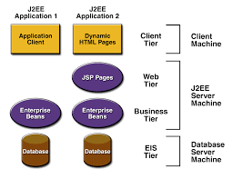
J2EE Applications

Slide 14
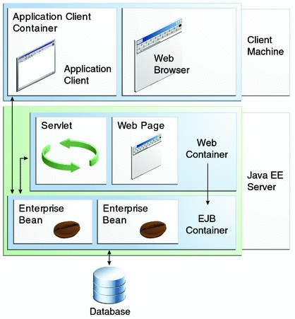
J2EE Containers

Slide 15
JAVA Applications vs. Platforms
Applications
Web Container
JVM
EJB Container
KVM/CDC and CLDC
Console/Windows Applications
Web Application
Enterprise Application
Micro Applications
J2SE API
Servlet/JSP API
EJB API
J2ME API

Slide 16
JAVA/J2EE Frameworks
Struts for Web Application Development
Hibernate(ORM) for DB Connectivity Development
JSF for Web Application Development
Spring for Everything
JAVAFX for Web Application Development

Slide 17
JAVA Servers
Glassfish
Apache Tomcat
JBOSS
Apache TomEE
Wildfly
Jetty
JOnAs
Apache Geronimo
Notes:
JRE, JDK, Java EE, Java ME and Java FX are major elements of Java Technology.

Slide 18
JAVA 5.0 Features
Generics
Enhanced For Loop
Auto boxing / Unboxing
Enums
Varags
Static Import
Metadata / Annotations
Garbage Collectors
Java Concurrent package
Notes:
JRE, JDK, Java EE, Java ME and Java FX are major elements of Java Technology.

Slide 19
JAVA 6.0 Features
Scripting Language Support
Performance improvements
JAX-WS
JDBC 4.0
Java Compiler API
JAXB 2.0 and StAX parser
Pluggable annotations
New GC algorithms
Notes:
JRE, JDK, Java EE, Java ME and Java FX are major elements of Java Technology.

Slide 20
JAVA 7.0 Features
Strings in switch
Automatic resource management in try-statement
The diamond operator
Binary integer literals
Underscores in numeric literals
Improved exception handling
Notes:
JRE, JDK, Java EE, Java ME and Java FX are major elements of Java Technology.

Slide 21
JAVA 8.0 Features
Lambda expression support in APIs
Functional interface & default methods Optionals
Nashorn – JavaScript runtime which allows developers to embed JavaScript code within applications
Annotation on Java Types
Unsigned Integer Arithmetic
Repeating annotations
New Date and Time API
Statically-linked JNI libraries
Notes:
JRE, JDK, Java EE, Java ME and Java FX are major elements of Java Technology.

Slide 22
JAVA & J2EE APIs
Enterprise JavaBeans Technology (EJB)
Java Message Service (JMS)
Java Servlet Technology (Servlet/Web Component)
JavaServer Faces Technology (JSF)
JavaServer Pages Technology (JSP)
JavaServer Pages Standard Tag Library (JSTL)
Java Persistence API (JPA)
Java Transaction API (JTA)
Notes:
JRE, JDK, Java EE, Java ME and Java FX are major elements of Java Technology.

Slide 23
JAVA & J2EE APIs
Java API for RESTful Web Services
Contexts and Dependency Injection for the Java EE Platform
Dependency Injection for Java
Bean Validation
Java EE Connector Architecture
JavaMail API
Java Authorization Contract for Containers
Java Authentication Service Provider Interface for Containers
Notes:
JRE, JDK, Java EE, Java ME and Java FX are major elements of Java Technology.

Slide 24
JAVA & J2EE APIs
Java Database Connectivity API
Java Naming and Directory Interface API
JavaBeans Activation Framework
Java API for XML Processing
Java Architecture for XML Binding
SOAP with Attachments API for Java
Java API for XML Web Services
Java Authentication and Authorization Service
Notes:
JRE, JDK, Java EE, Java ME and Java FX are major elements of Java Technology.

Slide 25
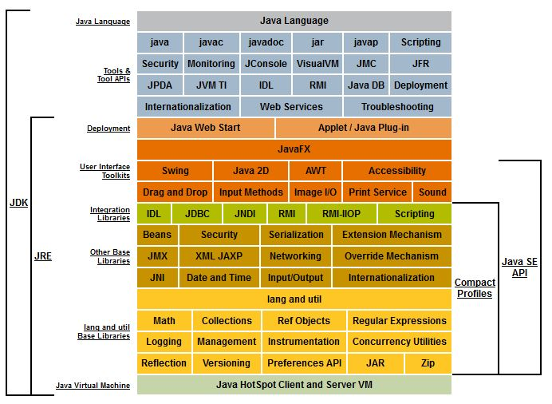
JAVA APIs Picture
Notes:
JRE, JDK, Java EE, Java ME and Java FX are major elements of Java Technology.

Slide 26
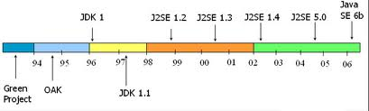
JAVA evolution
Notes:
JRE, JDK, Java EE, Java ME and Java FX are major elements of Java Technology.

Slide 27
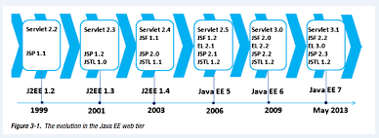
J2EE evolution
Notes:
JRE, JDK, Java EE, Java ME and Java FX are major elements of Java Technology.

Slide 28
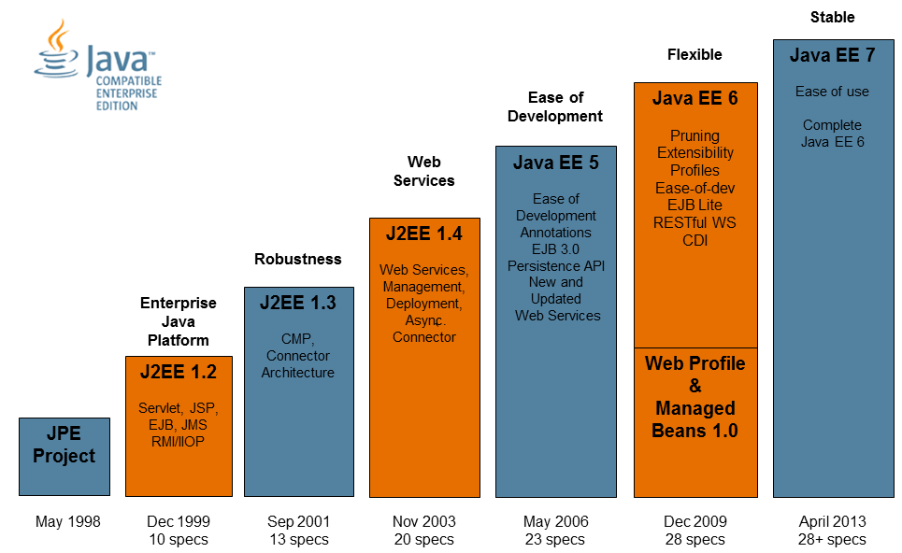
J2EE evolutions
Notes:
JRE, JDK, Java EE, Java ME and Java FX are major elements of Java Technology.

